Slide 1
Thinking in React

Slide 2
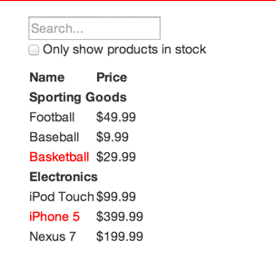
Building a searchable product data table using React
[
{category: "Sporting Goods", price: "$49.99", stocked: true, name: "Football"},
{category: "Sporting Goods", price: "$9.99", stocked: true, name: "Baseball"},
{category: "Sporting Goods", price: "$29.99", stocked: false, name: "Basketball"},
{category: "Electronics", price: "$99.99", stocked: true, name: "iPod Touch"},
{category: "Electronics", price: "$399.99", stocked: false, name: "iPhone 5"},
{category: "Electronics", price: "$199.99", stocked: true, name: "Nexus 7"}
];

Slide 3
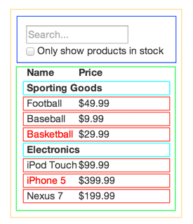
Here we have five components in our app.
FilterableProductTable (orange): contains the entirety of the example
SearchBar (blue): receives all user input
ProductTable (green): displays and filters the data collection based on user input
ProductCategoryRow (turquoise): displays a heading for each category
ProductRow (red): displays a row for each product

Slide 4
Break The UI Into A Component Hierarchy
Build A Static Version in React
Identify The Minimal (but complete) Representation Of UI State
Identify Where Your State Should Live

